Slide 1
Corporate Intranet Portal
Project Report

Slide 2
Project Overview
• Secure internal portal for employees
• Role-based authentication (Admin/Employee)
• Modules: Dashboard, Documents, Announcements, Attendance, Leaves
• React + Node.js + MongoDB architecture

Slide 3
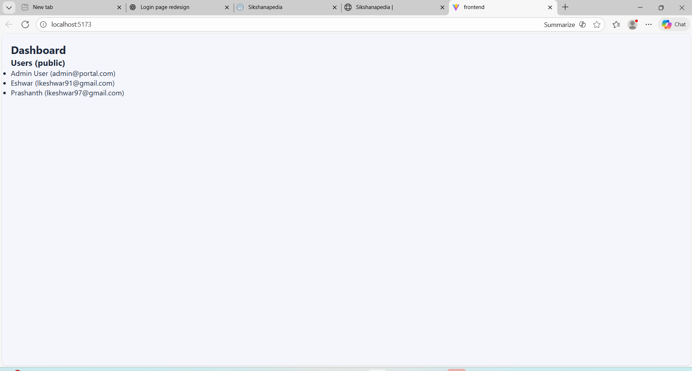
ER Diagram

Slide 4
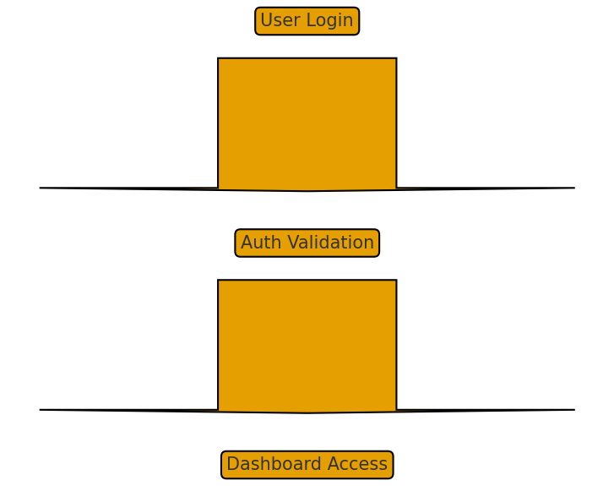
System Flowchart

